Slide 1
DMA Controller 8257

Slide 2
DMA Controller 8257
The Direct Memory Access or DMA mode of data transfer is the fastest amongst all the modes of data transfer.
In this mode, the device may transfer data directly to/from memory without any interference from the CPU.
The device requests the CPU (through a
DMA controller) to hold its data, address and
control bus, so that the device may transfer
data directly to/from memory.

Slide 3
Intel’s 8257 is a four channel DMA controller designed to be interfaced with their family
of microprocessors.
The 8257, on behalf of the devices, requests the CPU for bus access using local bus request input i.e. HOLD.
On receiving the HLDA signal from the CPU, the requesting devices gets the access of the bus, and it completes the required number of DMA cycles for the data transfer and then hands over the control of the bus back to the CPU.

Slide 4
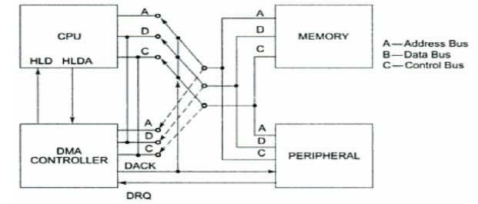
Operation of DMA

Slide 5
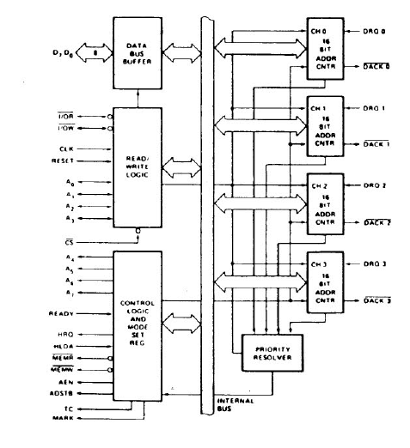

Slide 6
The chip support four DMA channels, i.e. four peripheral devices can independently request for DMA data transfer through these channels at a time.
Each of four channels of 8257 has a pair of two 16-bit registers, viz. DMA address register and terminal count register.

Slide 7
There are two common registers for all the channels, namely, mode set register and status register. Thus there are a total of ten registers.
The CPU selects one of these ten registers
using address lines Ao-A3.

Slide 8
DMA Address Register
Each DMA channel has one DMA address register. The function of this register is to store the address of the starting memory location, which will be accessed by the DMA channel. Thus the starting address of the memory block which will be accessed by the device is first loaded in the DMA address register of the channel.
The device that wants to transfer data over a DMA channel, will access the block of the memory with the starting address stored in the DMA Address Register.

Slide 9
Terminal Count Register
Each of the four DMA channels of 8257 has one terminal count register (TC).
This 16-bit register is used for ascertaining that the data transfer through a DMA channel ceases or stops after the required number of DMA cycles.
The low order 14-bits of the terminal count register are initialised with the binary equivalent of the number of required DMA cycles minus one.
After each DMA cycle, the terminal count register content will be decremented by one and finally it becomes zero after the required number of DMA cycles are over.

Slide 10
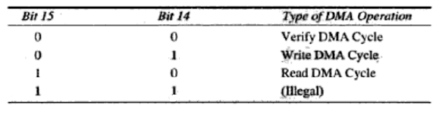
Terminal Count Register
The bits 14 and 15 of this register indicate the type of the DMA operation (transfer).

Slide 11
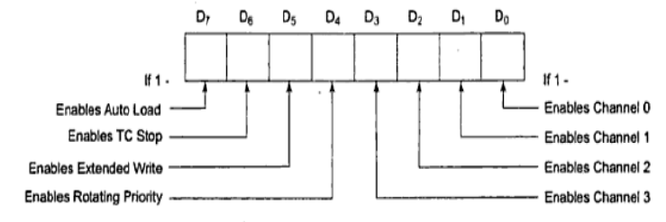
Mode Set Register
The function of the mode set register is to enable the DMA channels individually and also to set the various modes of operation.

Slide 12
Mode Set Register
The bits Do-D3 enable one of the four DMA channels of 8257. for example, if Do is ‘1’, channel 0 is enabled. If bit 4 is set, rotating priority is enabled, otherwise, the normal, i.e. fixed priority is enabled.
If the TC STOP bit is set, the selected channel is disabled after the terminal count condition is reached, and it further prevents any DMA cycle on the channel

Slide 13
Mode Set Register
The auto load bit, if set, enables channel 2 for the repeat block chaining operations, without immediate software intervention between the two successive blocks.

Slide 14
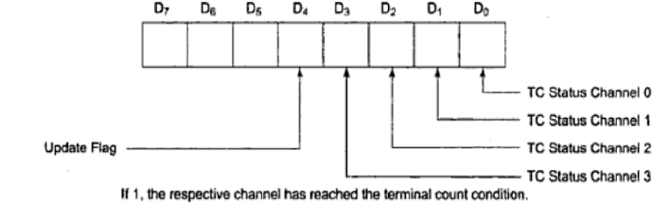
Status Register
The lower order 4-bits of this register contain the terminal count status for the four individual channels

Slide 15
Status Register
If the update flag is set, the contents of the channel 3 registers are reloaded to the corresponding registers of channel 2 whenever the channel 2 reaches a terminal count condition, after transferring one block and the next block is to be transferred using the autoload feature of 8257.

